Slide 1
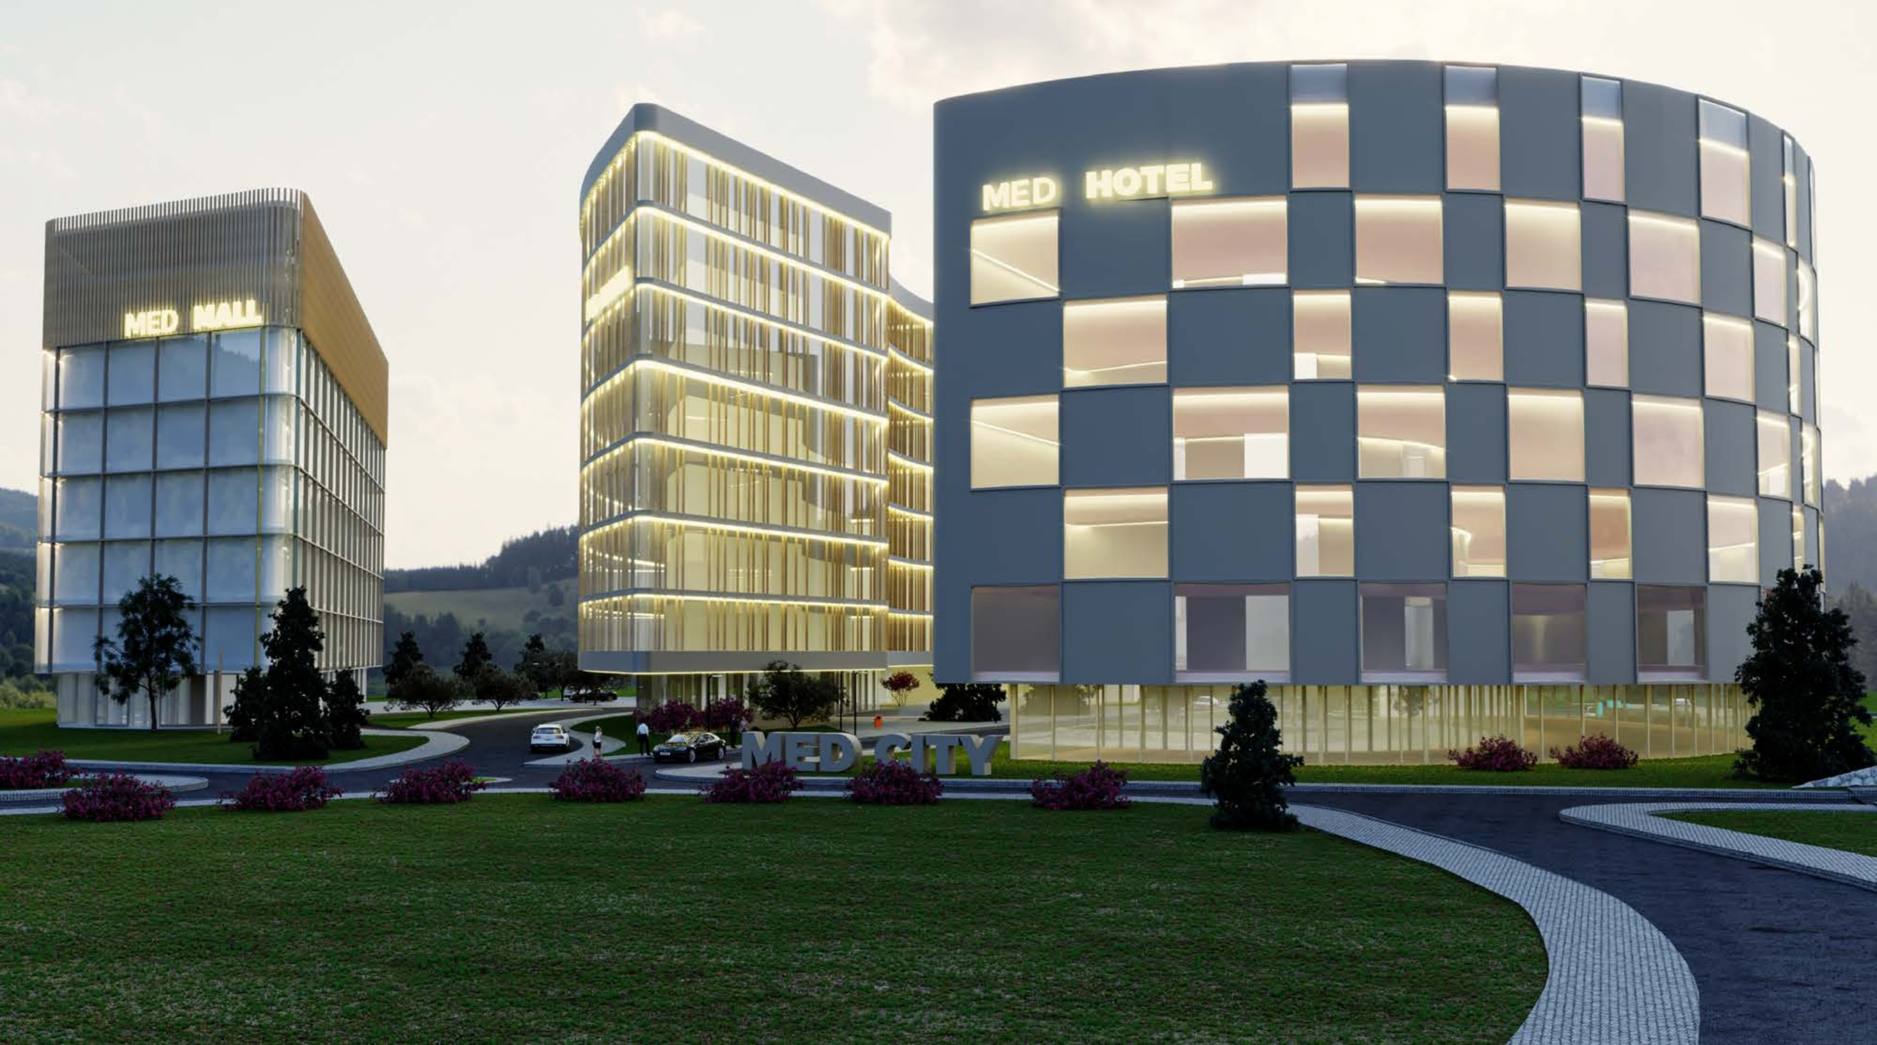
MedCity
Sarajevo

Slide 2
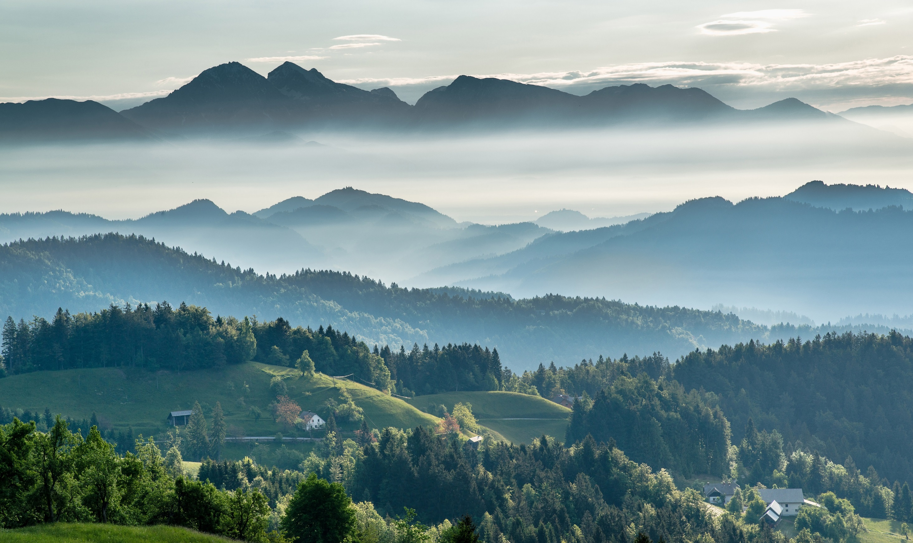
Landscape

Slide 3
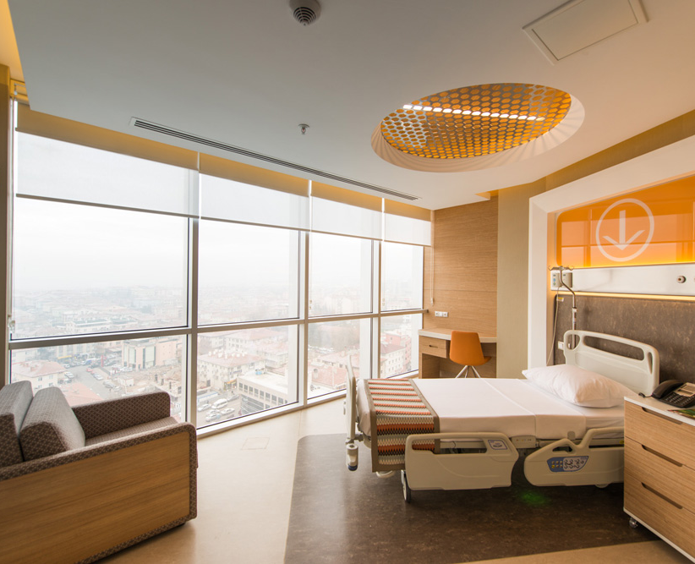
Inspired

Slide 4
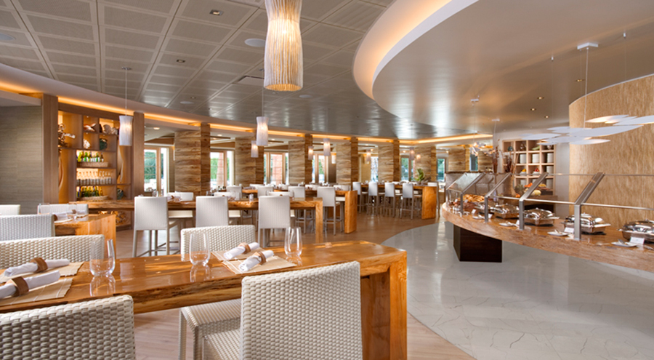
Luxury

Slide 5
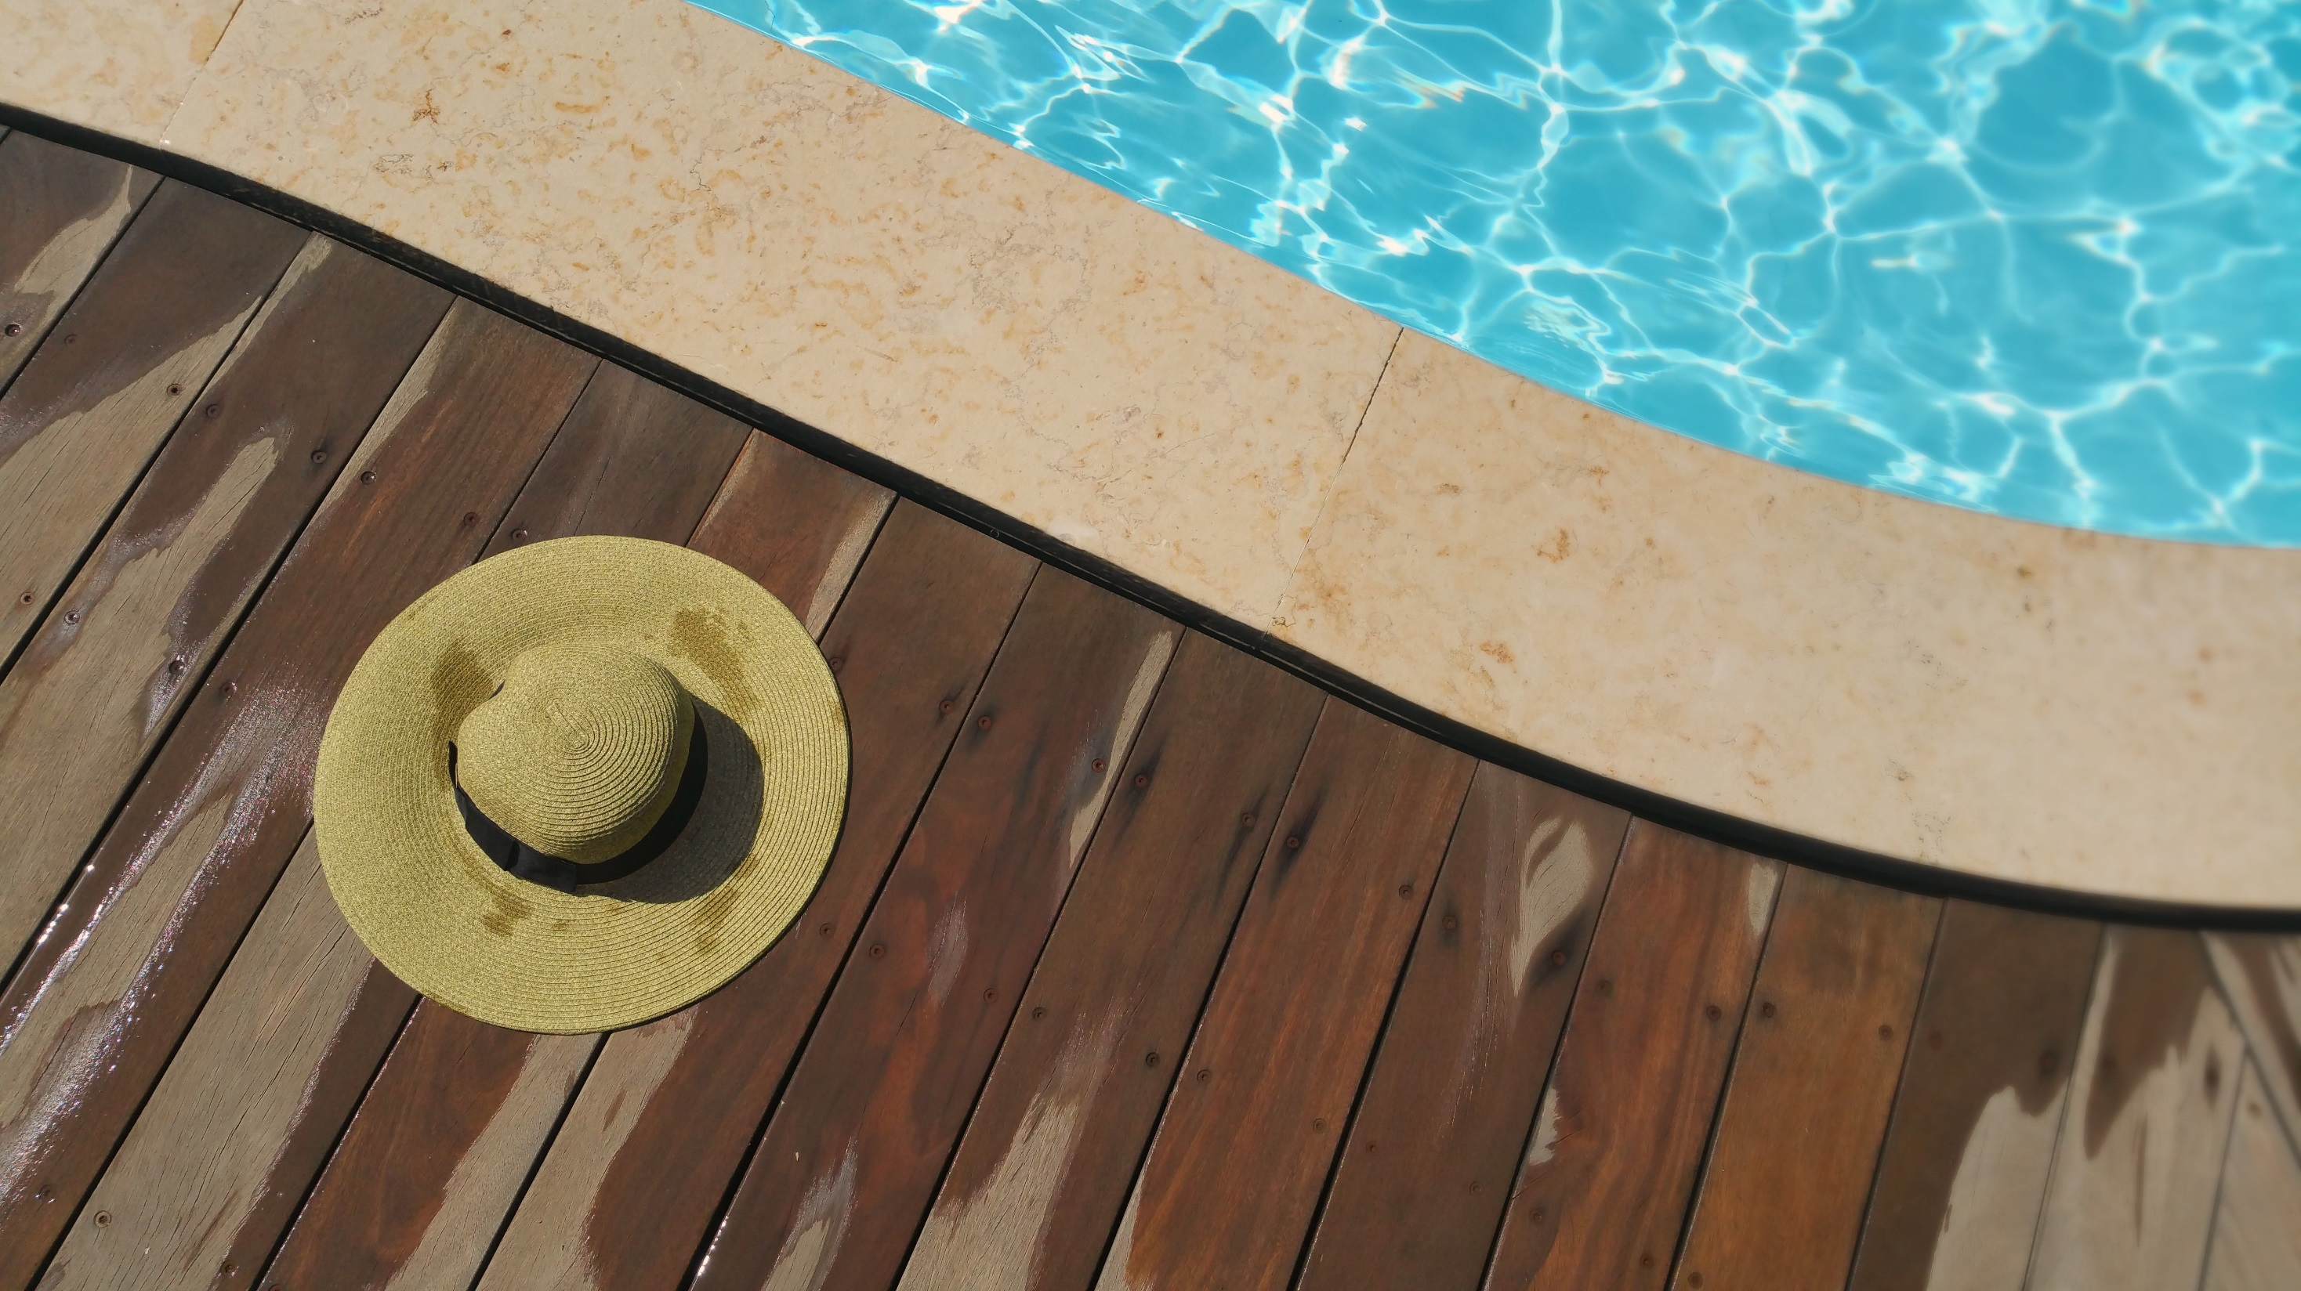
Pool

Slide 6


Wellness

Slide 7

Celebrations

Slide 8

Weddings

Slide 9

Restaurant

Slide 10
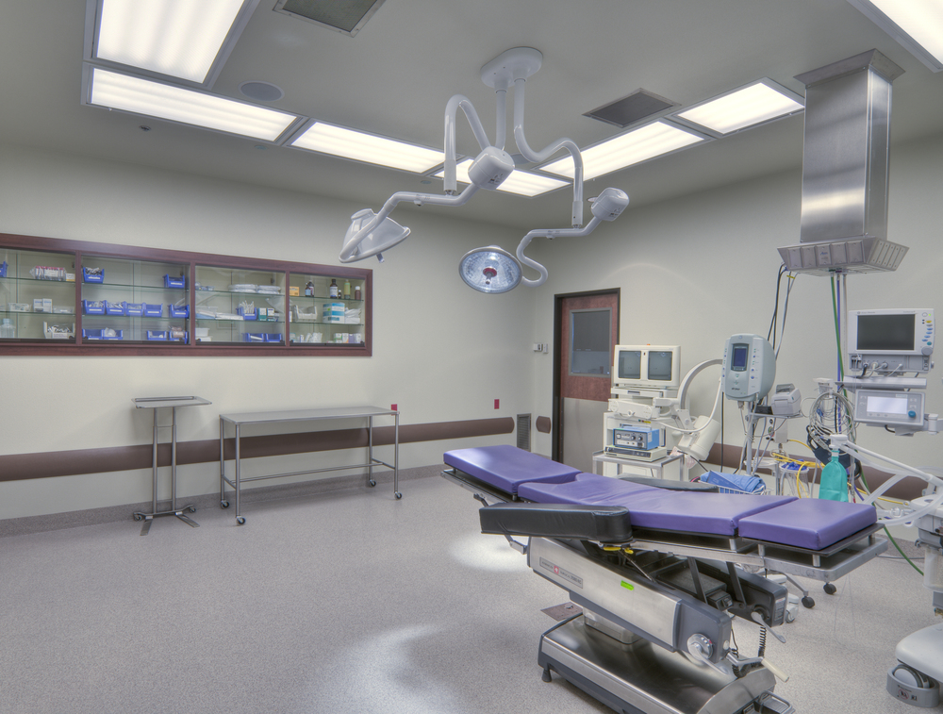
Medical

Slide 11

Service

Slide 12

Rooms

Slide 13
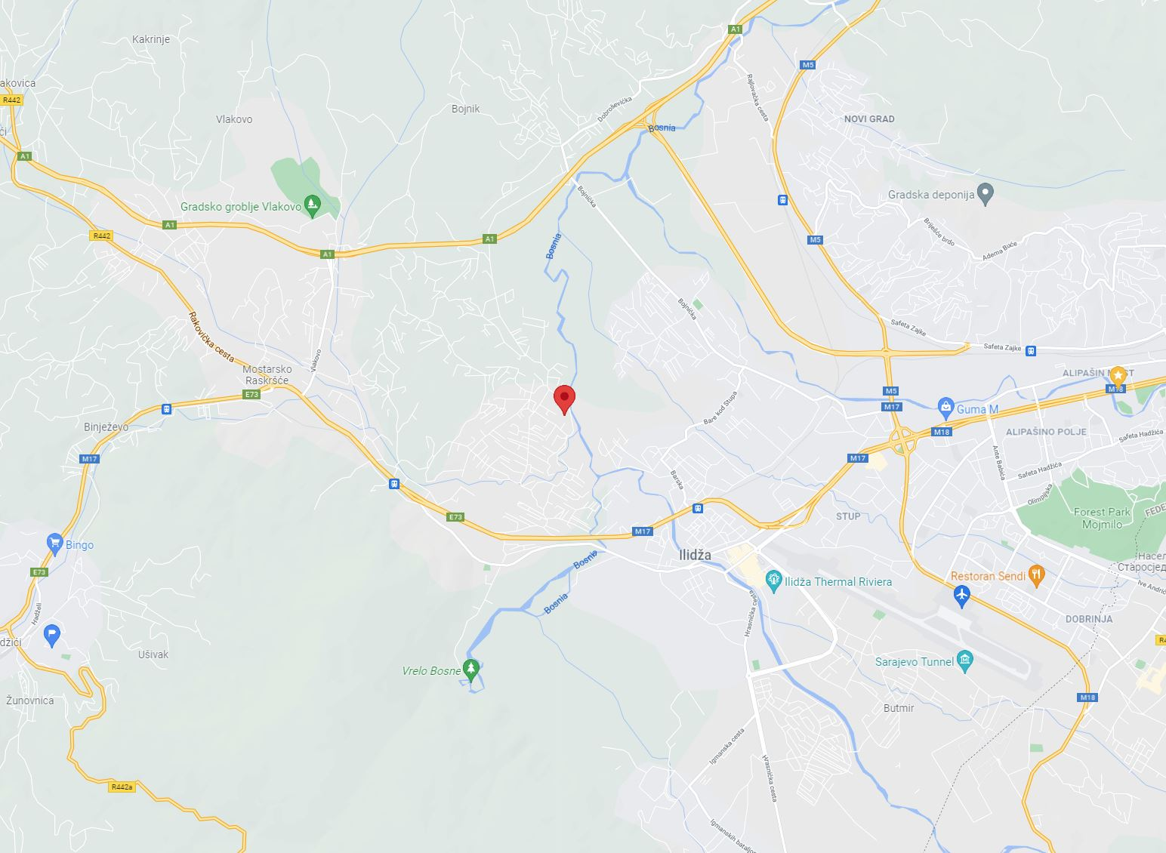
3 km from Ilidza
5 km from the airport
location

Slide 14
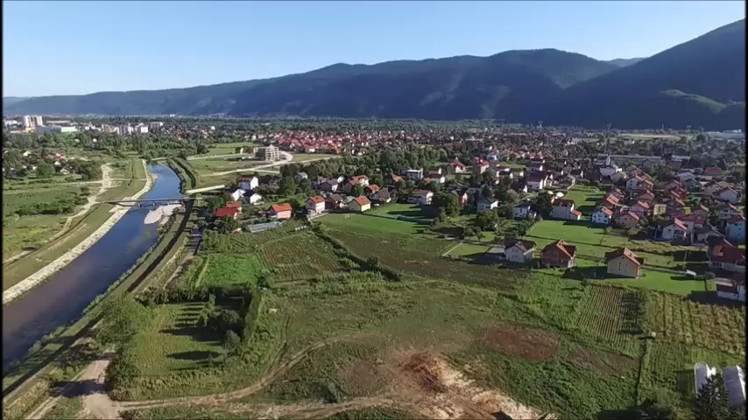

Slide 15
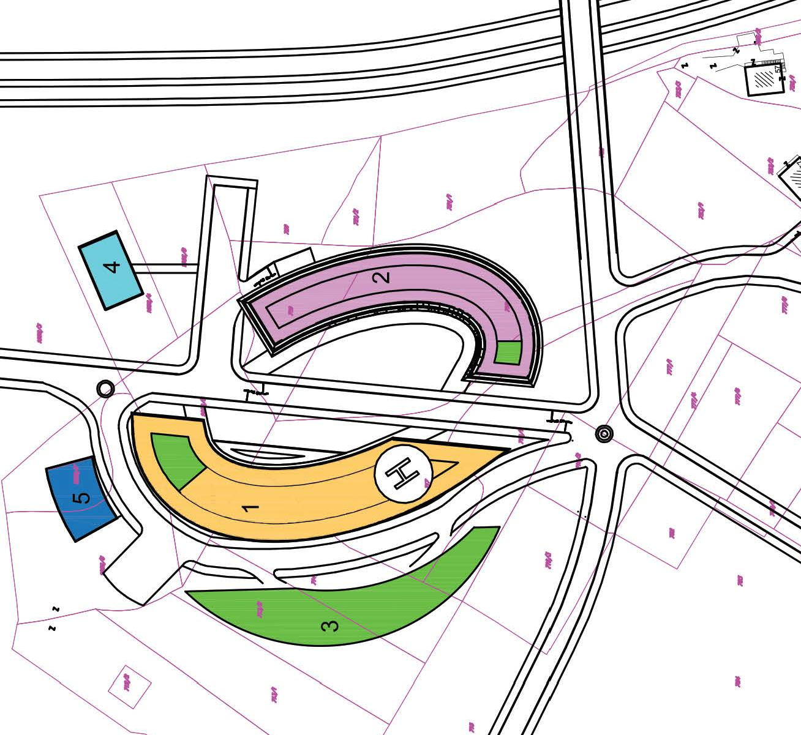
CURRENT MASTER PLAN

Slide 16
Areas
Building No. | 1 | 2 | 3 | 4 | 5 | TOTAL | GRAND TOTAL
-3. FLOOR | - | - | - | - | - | - | 8,860
-2. FLOOR | - | - | - | - | - | - | 8,860
-1. FLOOR | - | - | - | - | - | - | 8,860
GROUND FLOOR | 1,030 | 1,382 | 1,144 | 240 | 300 | 4,096
1ST FLOOR | 2,213 | 1,528 | 1,144 | 240 | 300 | 5,425
2ND FLOOR | 1,994 | 1,725 | 1,144 | 240 | 300 | 5,403
3RD FLOOR | 1,844 | 1,878 | 1,144 | - | 300 | 5,166
4TH FLOOR | 1,638 | 1,952 | 1,144 | - | - | 4,734
5TH FLOOR | 1,613 | 1,726 | 1,144 | - | - | 4,483
6TH FLOOR | 1,769 | 1,598 | 1,144 | - | - | 4,511
7TH FLOOR | 1,969 | 50 | 1,144 | - | - | 3,163
8TH FLOOR | 164 | - | 61 | - | - | 225
TOTAL | 14,234 | 11,839 | 9,213 | 720 | 1,200 | 37,206 | 63,786
Net SM 55,627
Gross SM 63,786
Net to Gross 87%

Slide 17
MULTI PHASED approach
Incremental investment

Slide 18
dynamics
Development begins in December 2021
Construction begins in May 2022
Construction ends in May 2025 after 36 months.
Leasing begins in November 2023, 18 months after construction starts.
Units are fully leased (per Occupancy Rate) in June 2025, 1 months after construction ends
Exit sale is in November 2025
Notes:
This template was inserted from Power-user, the productivity add-in for PowerPoint, Excel and Word.
Install Power-user to access thousands of templates, icons, maps, diagrams and charts with Power-user.
Visit https://www.powerusersoftwares.com/
©Power-user SAS, terms of license: https://www.powerusersoftwares.com/terms

Slide 19
Financing thousand euros
Project Cost 52,285,907
Required Equity 24,817,015
Loan Amount 22,420,657
Equity share is 53% of total investment
Debt share is 47% of total investment

Slide 20
REGIONAL CENTER
Varaždinska
Medimurska
Krapinsko-Zagorska
Koprivničko-Križevačka
Severno-Backi
Severno-Banatski
Grad Zagreb
Viroviticko-Podravska
Croatia
Zagrebacka
Bjelovarska-Bilogorska
Zapadno-Backi
17 mil people in the region
3.6 mil in Bosnia
1.2 mil arrivals to Sarajevo airport in 2019
Primorsko-Goranska
Osjecko-Baranjska
Bosnia
Srednje-Banatski
Sisacko-Moslavacka
Požega-Slavonia
Južno-Backi
Istarska
Karlovacka
Brčko district
Sremski
Južno-Banatski
1
Vukovarsko-Srijemska
Licko-Senjska
Brodsko-Posavska
Macvanski
Grad Beograd
1+
Podunavski
Branicevski
1
< 1
Kolubarski
Borski
[200 to 300[
Serbia (with Kosovo)
1+
1
[300 to 400[
Šumadijski
< 1
Zadarska
Republika Sprska
Pomoravski
[200 to 300[
400+
Moravicki
1+
400+
[300 to 400[
< 1
Federation of Bosnia and Herzegovina
400+
Zlatiborski
Zajecarski
400+
400+
[200 to 300[
1
Rasinski
400+
[300 to 400[
400+
Raški
400+
1
400+
Šibensko-Kninska
400+
Pljevlja
Nišavski
400+
400+
Splitsko-Dalmatinska
Plužine
Žabljak
Bijelo Polje
400+
1+
Toplicki
Pirotski
400+
400+
< 1
1
[200 to 300[
Šavnik
Mojkovac
Rožaje
Kosovsko-Mitrovački
400+
1
400+
[300 to 400[
Nikšic
400+
400+
Kolašin
Andrijevica
Jablanicki
400+
Danilovgrad
Berane
400+
Dubrovacko-Neretvanska
400+
Kotor
400+
Herceg Novi
Montenegro
400+
1
Cetinje
Podgorica
Plav
Pećki
Kosovski
Tivat
Budva
Pcinjski
Bar
Kosovsko-Pomoravski
Ulcinj
Prizrenski

Slide 21
The Market
Bosnia
Sarajevo Residents
Other
Qatar
Other EU Countries
Saudi Arabia
Customers
Montenegro
UAE
Croatia
Kuwait
Serbia
Bahrain
Foreign Students
Expatriates
Notes:
This template was inserted from Power-user, the productivity add-in for PowerPoint, Excel and Word.
Install Power-user to access thousands of templates, icons, maps, diagrams and charts with Power-user.
Visit https://www.powerusersoftwares.com/
©Power-user SAS, terms of license: https://www.powerusersoftwares.com/terms

Slide 22
Business model canvas
Key partners
Key Activities
Value Propositions
Customer Relationship
Customer Segments
OPERATING PARTNERS
Partner Group One.
1. General Managing Partner, with 22% ownership.
2. Vice Managing Partner for Hospitality and Human Resource Operations, with 15% ownership.
3. Vice Managing Partner for Laundry and Maintenance, with 15% ownership.
4. Vice Managing Partner for, Kitchen and Catering Operations, with 15% ownership.
INVESTMENT PARTNERS
1. Limited Partner Group One, with 67% ownership. aka Operating Partners
2. Limited Partner Group Two, with 22% ownership, aka Anchor Investor 2
3. Mr. Semsudin Makic, with 11% ownership. aka Anchor Investor 1
MedlPark Sarajevo is the home of trust in healthcare with its expert physicians and
healthcare staff, patient-oriented service approach, quality policy, state of the art
diagnosis and treatment centers, and comfortable facilities.
^{Gynecology:}
^{PAP Tests}
^{Annual Women Exam}
^{Family Planning}
^{Acute Gyn. Problems}
^{Pediatrics:}
^{Newborn Care}
^{Infant Care}
^{Annual Physicals}
^{Routine Services}
^{Possible Immunizations}
^{Dermatology:}
Removal of minor lesions, skin tags, moles and warts
Biopsies of suspicious dermatological lesions and/or referral
^{Allergy Testing and shots}
^{Tetanus}
^{Pneumovax}
^{Immunizations}
^{Minor Surgery:}
^{Laceration Repair}
^{Lesion Removals}
Hyfrecation for Lesions and Blemishes
^{Adult Medicine:}
Preventative and Routine Services
^{Diabetic Teaching}
Nutritional/ Dietician Services
Exercise and Obesity Counseling
^{Hair Transplants}
^{Cardiology:}
^{EKGs}
^{Possible Stress Testing}
To develop the fully functional hospital project
To create a medical practice that will exceed patients' expectations
To provide high-quality health care to residents and non-residents
To create a medical practice that helps serve the community's needs
To form a health care practice that is able to survive off its own cash flow in 10 months or less
To increase the number of patients by 20% per year through superior performance and word-of-mouth referrals
To develop a comprehensive website that includes online booking capability, as well as additional information about the practice, hours, demographic information, health information and much more
Establish long-term customer relationships
Key Resources
Channels
Local Staff
Local Management
Foreign Management
Partner Network
Internet
Tourist Agencies
Cost Structure
Revenue Streams
Real Estate Development
Post development Management
Apartment/Hotel Rent
Offices Rent
Hospital Rent
Retail Spaces Rent
Parking
Sale
Notes:
This template was inserted from Power-user, the productivity add-in for PowerPoint, Excel and Word.
Install Power-user to access thousands of templates, icons, maps, diagrams and charts with Power-user.
Visit https://www.powerusersoftwares.com/
©Power-user SAS, terms of license: https://www.powerusersoftwares.com/terms

Slide 23
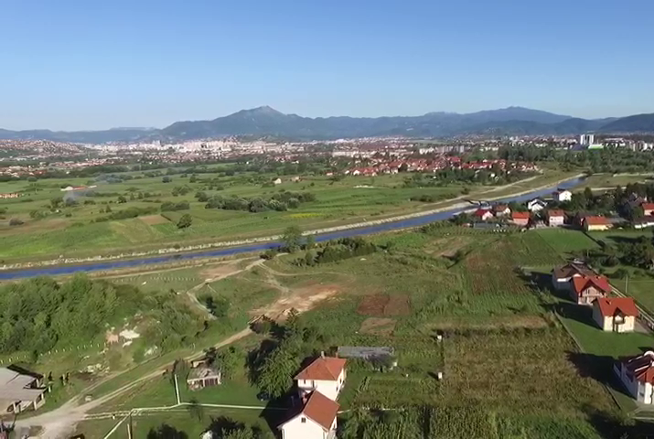
Before

Slide 24
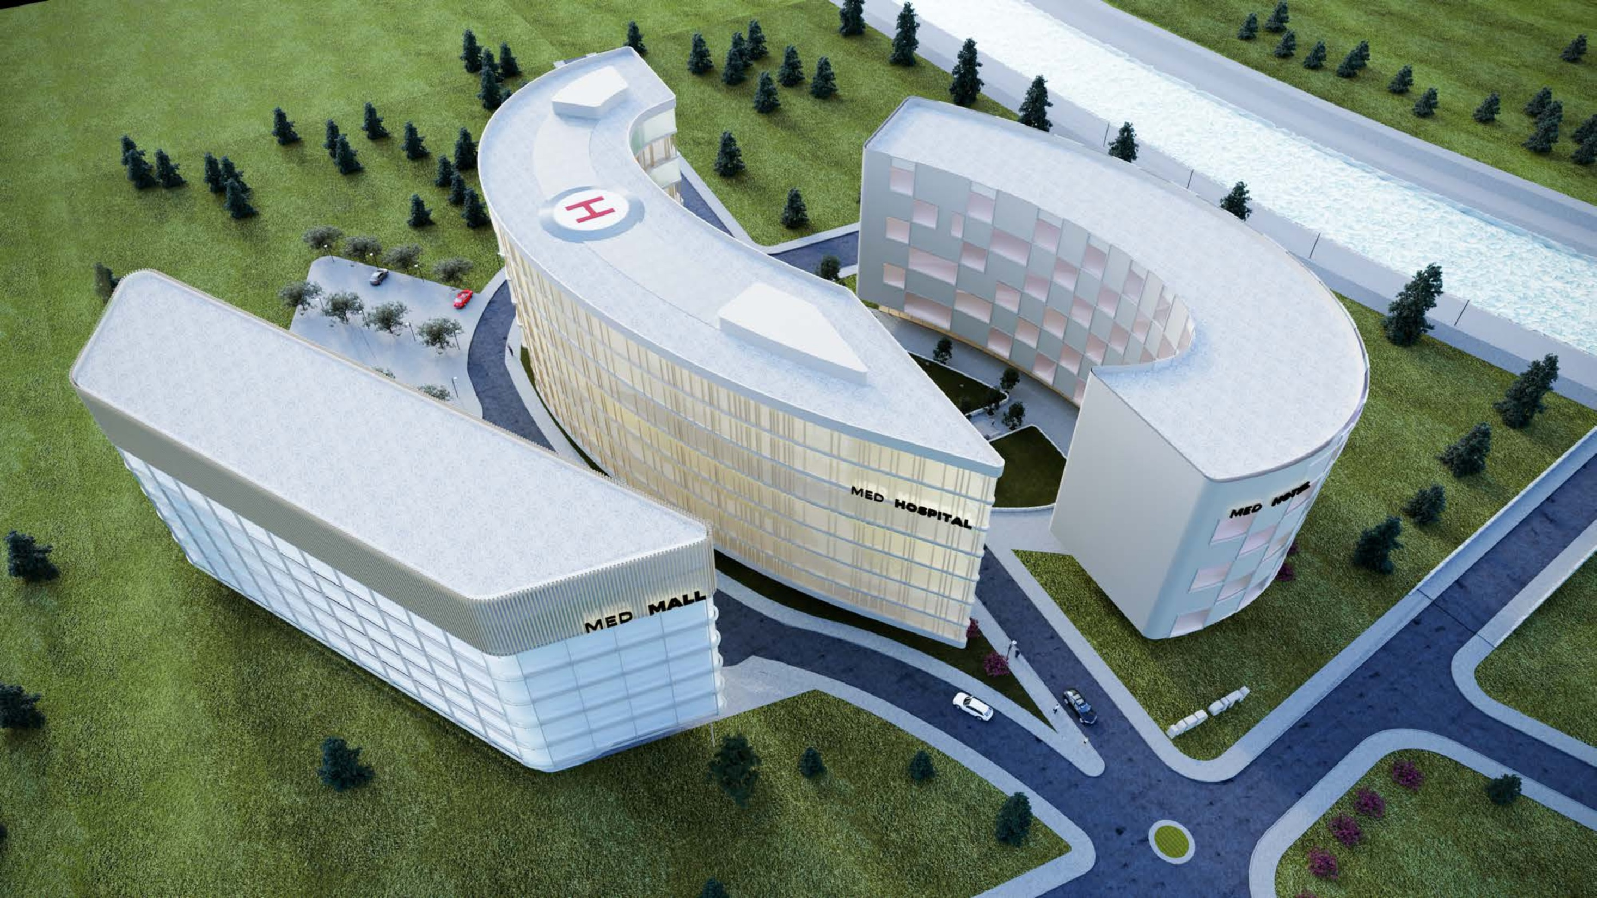
After

Slide 25
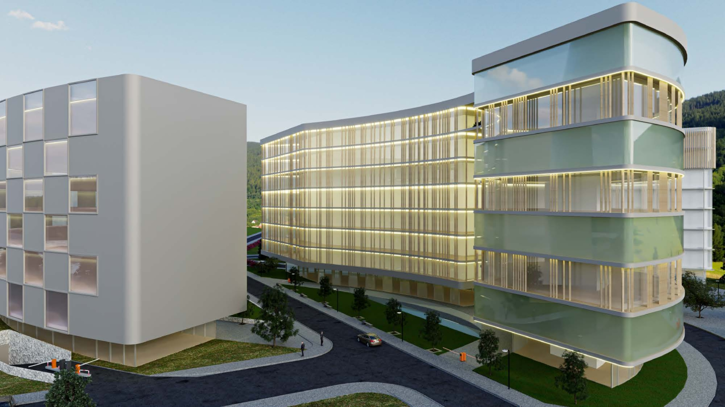
Visuals
Notes:
This template was inserted from Power-user, the productivity add-in for PowerPoint, Excel and Word.
Install Power-user to access thousands of templates, icons, maps, diagrams and charts with Power-user.
Visit https://www.powerusersoftwares.com/
©Power-user SAS, terms of license: https://www.powerusersoftwares.com/terms

Slide 26
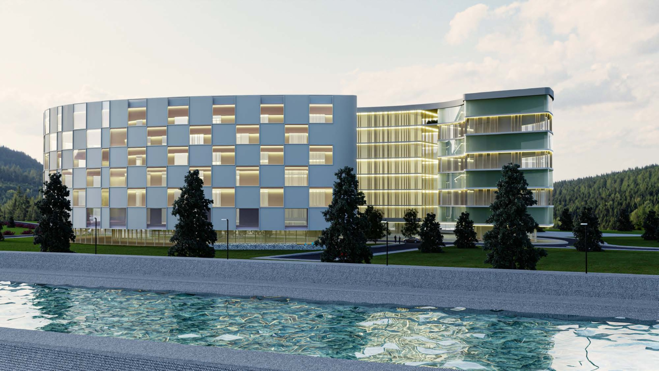

Slide 27
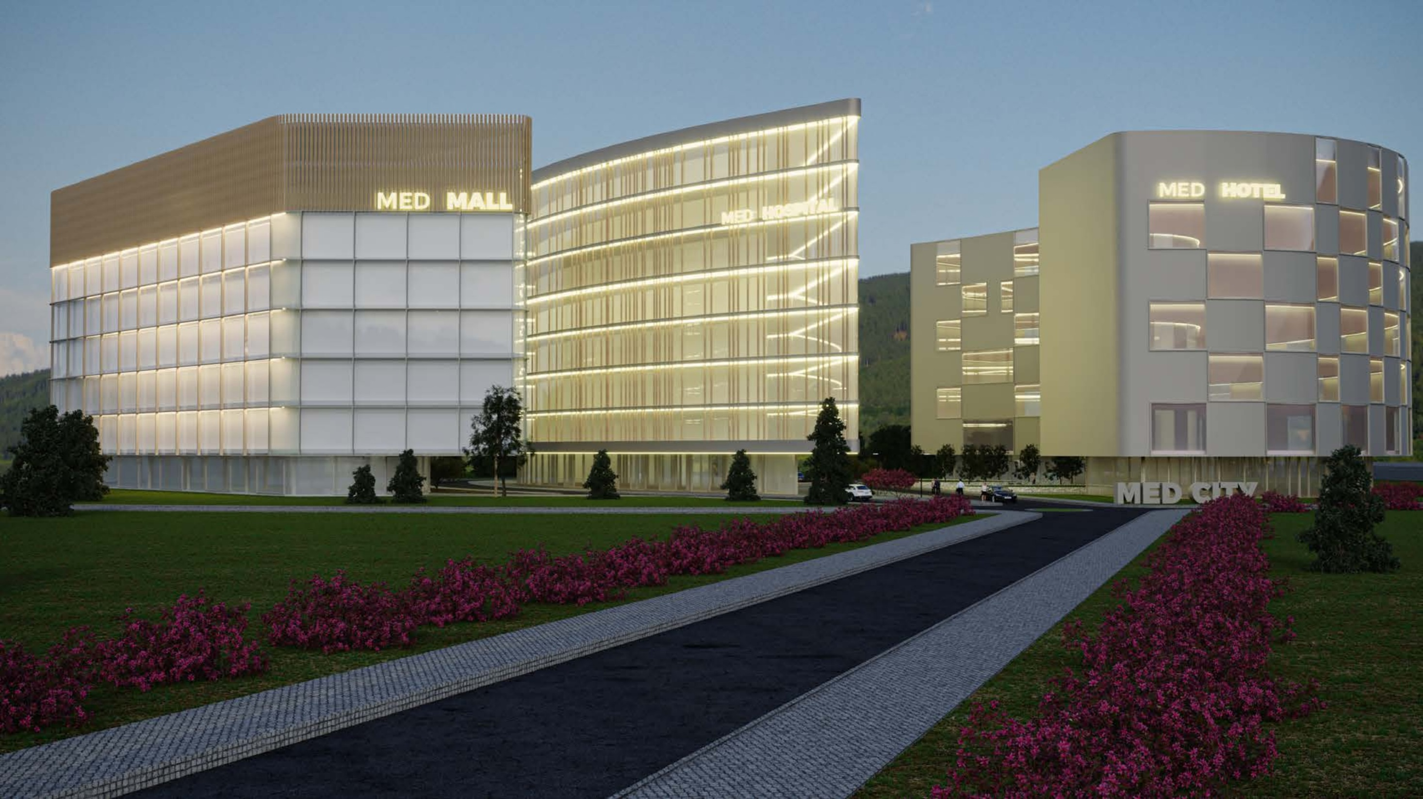

Slide 28
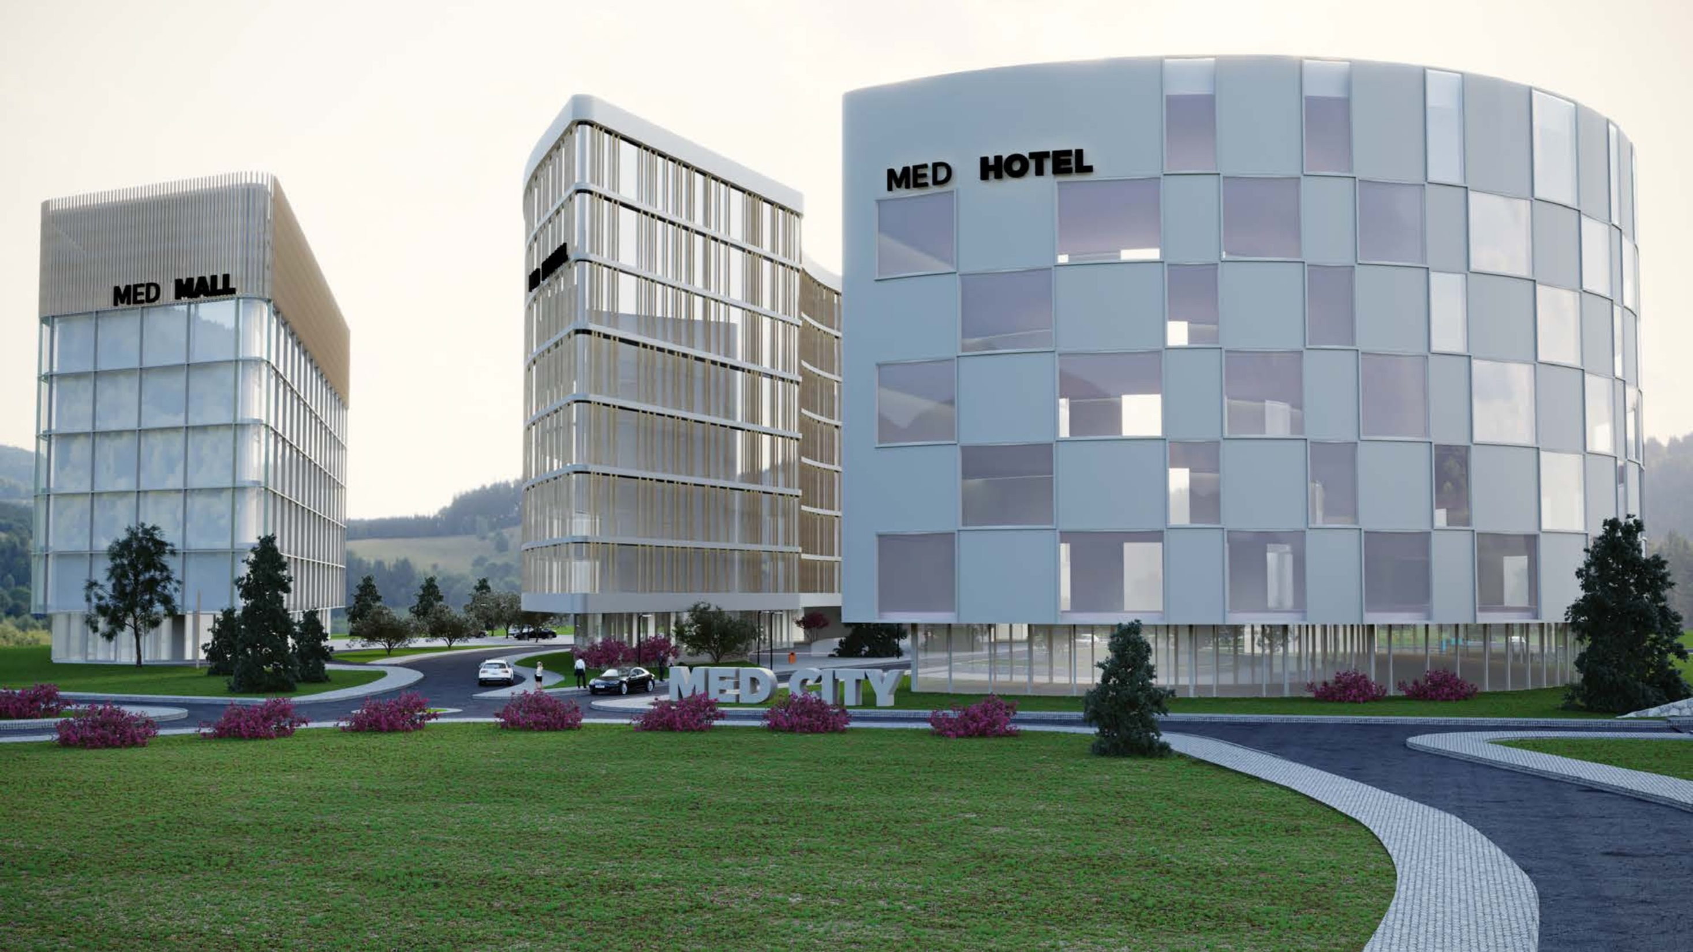

Slide 29


Slide 30
ASSUMptions
Totals
 |  | Total Development Cost |  | - | 50,793,999
 |  | Total Project Cost |  | - | 52,285,907
 |  | Total Project Cost per net m2 |  | - | 940
 |  | Total Project Cost per gross m2 |  | - | 820
Financing |  |  |  |  |  | Disposition
 | Project Cost |  | 52,285,907 |  |  |  | Cap Rate |  | 7.76%
 | Loan to Investment |  | 47.46% |  |  |  | Cost of Sale |  | 3.00%
 | Loan Amount |  | 22,420,657 |  |  |  | Date of Sale |  | Nov 2025
 | Interest Rate |  | 4.00%
 |  |  |  |  |  |  | Gross Sales Price |  | 72,179,228
 | Amortization (yr) |  | 10 |  |  |  | Gross Proceeds per m2 |  | 1,132
 | Grace Period (mo) |  | 18 |  |  |  | Net Proceeds per m2 |  | 1,098
 | Financing Fees |  | 1.00%
 | Prepayment Penalty |  | 1.00%
Capitalization |  |  |  |  |  | Returns and Yields
 | Required Equity |  | 24,817,015 |  |  |  | Stabilized NOI |  | 466,886
 |  |  |  |  |  |  | Yield on Cost |  | 43%
 | Anchor Investors |  | 6,700,594 |  |  |  | Yield on Equity |  | 91%
 | Equity placement |  | 27.00% |  |  |  | Project IRR |  | 23%
 | Equity Earned |  | 33.00% |  |  |  | Equity IRR |  | 27%
 | Equity Investors |  | 18,116,421 |  |  |  | Anchor Investors |  | 36%
 |  | Equity Placement | 73.00% |  |  |  | Equity Investors |  | 23%
 |  | Equity Earned | 67.00% |  |  |  | Total Project Profit |  | 22,576,312
 |  | Earned/Placement Ratio | 92%

Slide 31
Funding mil €
Development begins in December 2021
Construction begins in May 2022
Construction ends in May 2025 after 36 months.
Leasing begins in November 2023, 18 months after construction starts.
Units are fully leased (per Occupancy Rate) in June 2025, 1 months after construction ends
Exit sale is in November 2025
Notes:
This template was inserted from Power-user, the productivity add-in for PowerPoint, Excel and Word.
Install Power-user to access thousands of templates, icons, maps, diagrams and charts with Power-user.
Visit https://www.powerusersoftwares.com/
©Power-user SAS, terms of license: https://www.powerusersoftwares.com/terms

Slide 32
assumptions
FUNDING 000's |  |  |  | YR 1 | YR 2 | YR 3 | YR 4 | YR 5 | TOTAL
 | Equity |  |  | 18,329 | 5,953 | - | 535 | - | 24,817
 | Debt |  |  | - | 6,039 | 10,237 | 6,145 | - | 22,421
 | Total Investment |  |  | 18,329 | 11,992 | 10,237 | 6,679 | - | 47,238
IRR (ANNUAL) 000's |  |  |  |  |  |  |  |  | TOTAL
 | Project IRR |  | 23% | (18,329) | (11,942) | (9,797) | 63,912 | - | 23,844
 | Equity IRR |  | 27% | (18,329) | (5,953) | - | 46,859 | - | 22,576
 | Anchor Investors |  | 36% | (4,949) | (1,607) | - | 15,495 | - | 8,939
 | Equity Investors |  | 23% | (13,380) | (4,346) | - | 31,363 | - | 13,637

Slide 33
Funding dynamics

Slide 34
Next steps
Transfer the Land to the Company
Secure funding
Prepare designs
Execution
Land Transfer
Financing
Construction Designs
Execution

Slide 35
Thank you for your attention

